Slide 1

THE MILLION SONG RECOMMENDATION SYSTEM
GROUP 1
JIE LU
CHAOYING BAO
YIHAO LI
TRAM NGOC LE

Slide 2
Executive Summary
We aim to build a useable and comprehensive recommendation system for music recommendation.
Based on the Million Song Dataset and musiXmatch dataset, which include user listening history, song metadata, artist, artist similarity, and lyrics.
Compared and combined popularity based, collaborative filtering based, and content-based methods to build a recommending strategy for different scenarios and different users
The whole system was built utilizing python and pyspark on Google Cloud Platform.

Slide 3
Business Problem
An increasing number of online companies are utilizing recommendation systems to increase user interaction and enrich business potential.
The potential benefits of a state of art recommender system:
Improve user retention
Improve user engagement
Understand changing trend of the customers’ tastes
We want to focus on the streaming music industry and develop an industry level music recommendation system under different scenarios and for different users.

Slide 4



Data Description
The Echo Nest, 2011
Size: 280GB (Subset)
1,000,000 unique tracks ID
Song Metadata, Artist similarity, Artist tags
SQLite, Text Files
Main Dataset Link
musiXmatch
Size: 70MB
779K matches between of musiXmatch ID & MSD ID
210,519 BOW for training & 27,143 BOW for testing
SQLite & Text Files
Complementary Dataset Link
Taste Profile
Size: 488MB
48M user-song-play count triplets
1M unique users
380K unique songs
Tab-delimited
Complementary Dataset Link

Slide 5


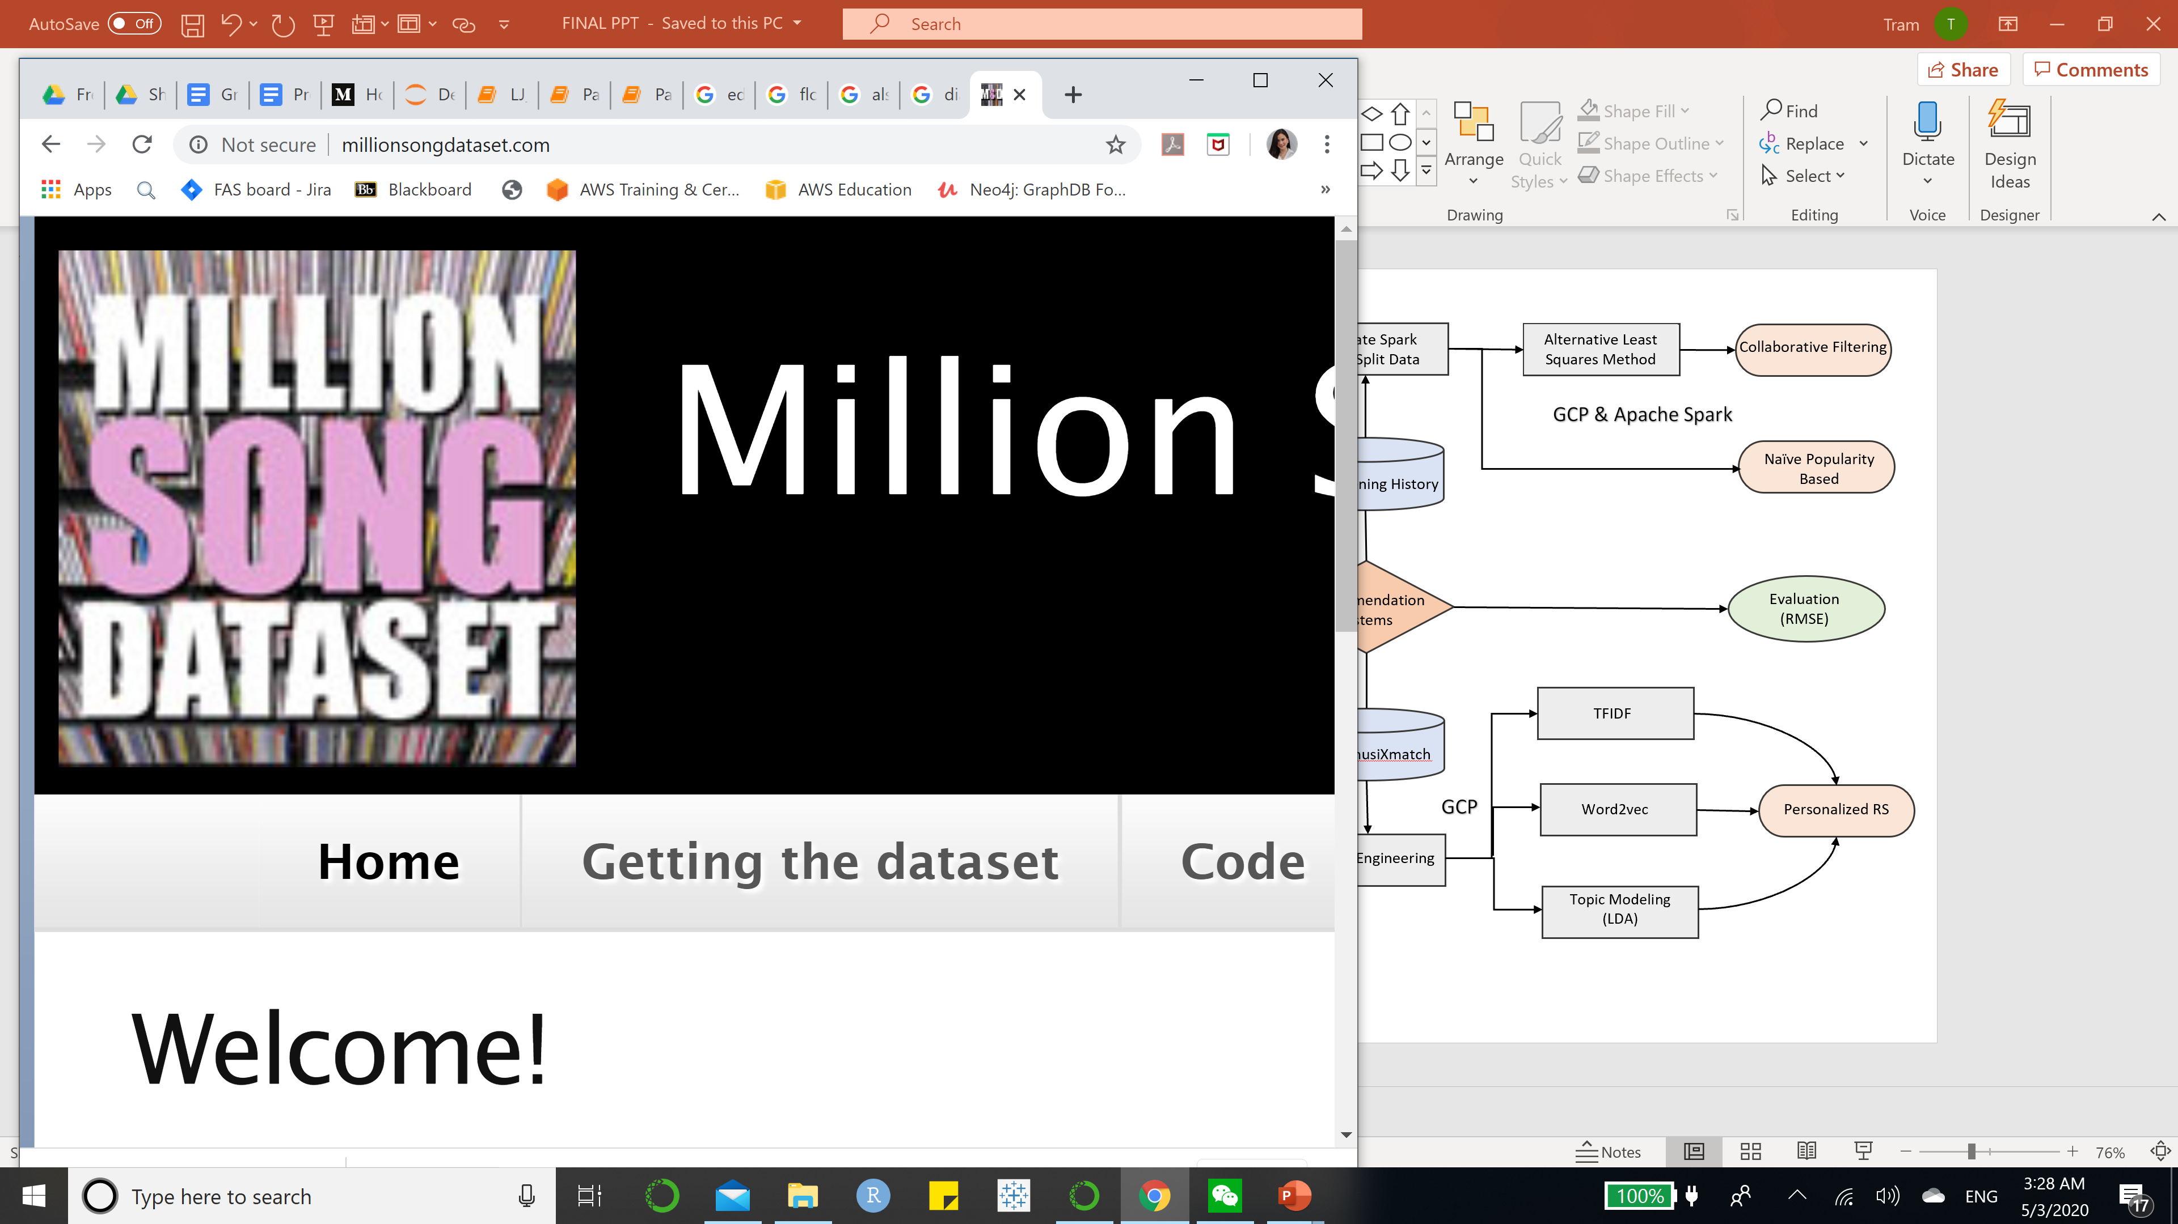
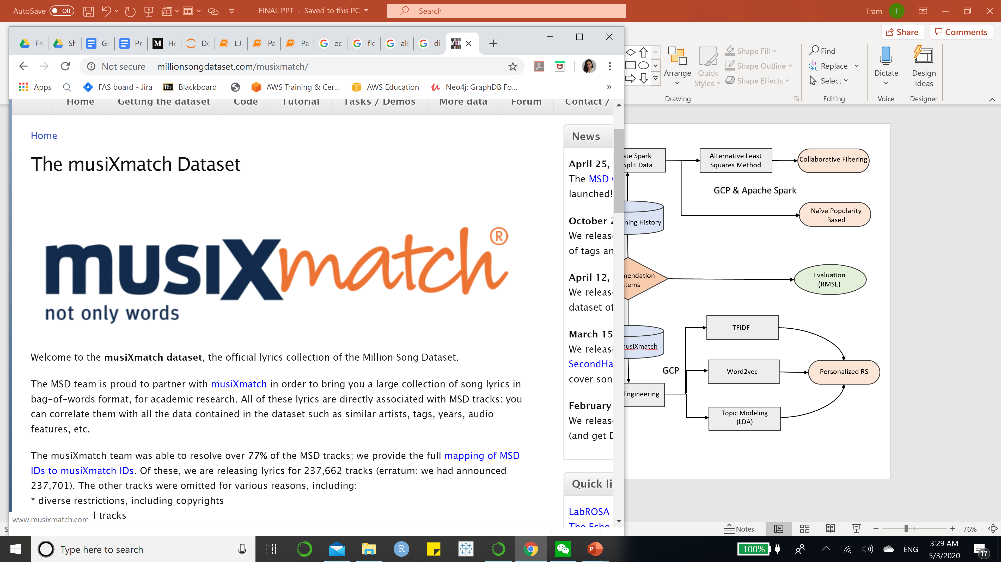
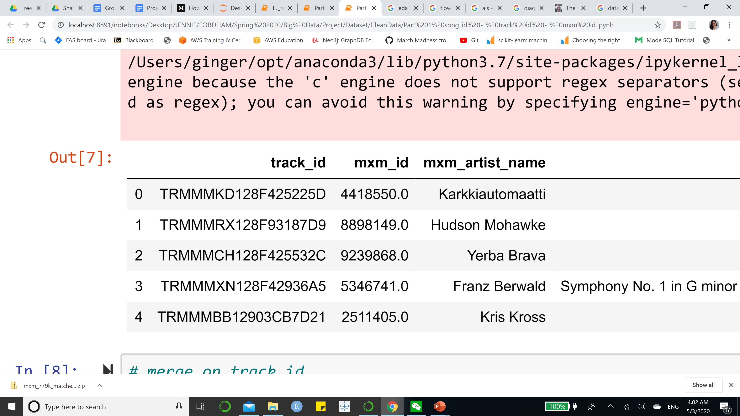
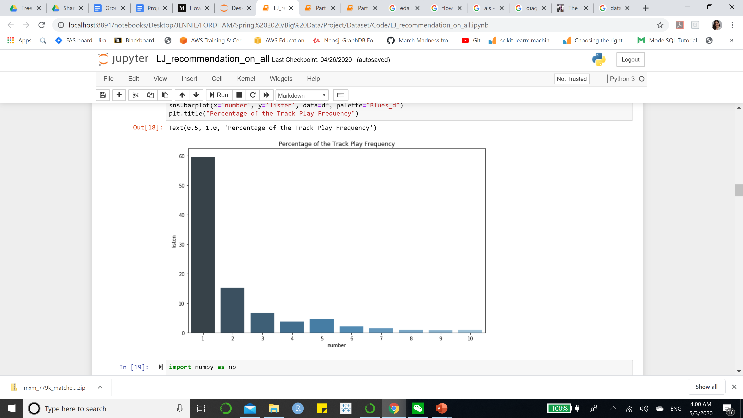
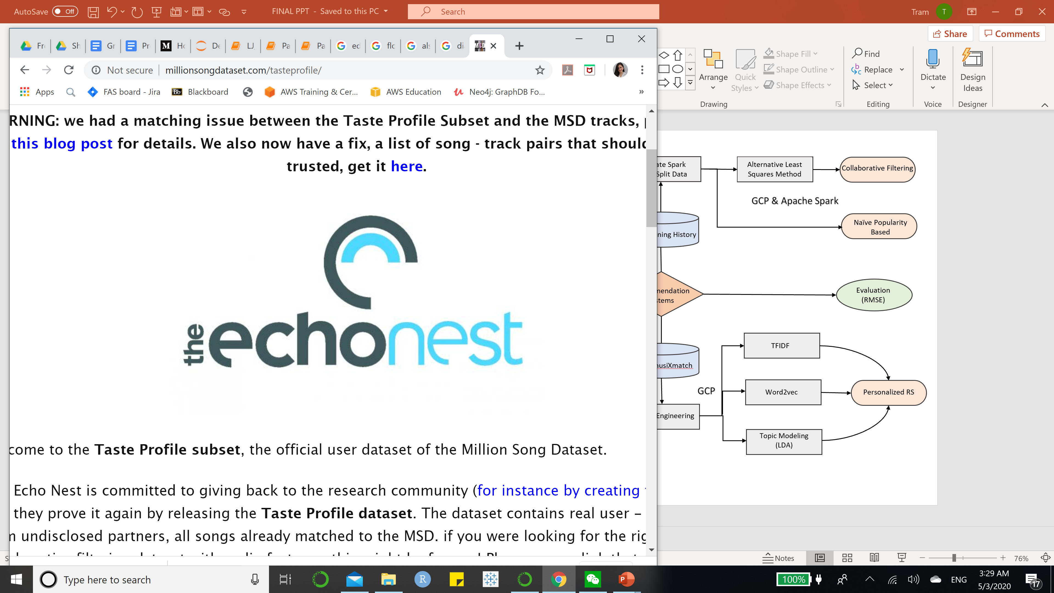

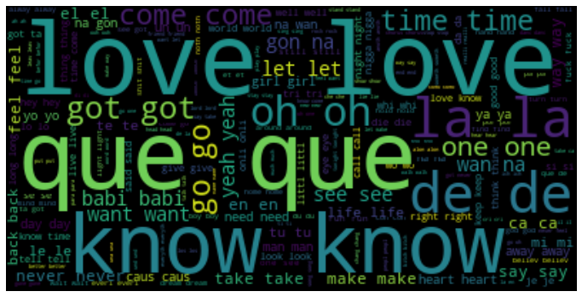
System Design
Generate Spark RDD + Split Data
Alternative Least Squares Method
Collaborative Filtering
Naïve Popularity Based
User Listening History
Data Collection
Data Preprocessing
Exploratory Data Analysis
Recommendation Systems
Evaluation
(RMSE)
TFIDF
SQLite, API, etc..
ID Mapping, Merging, Data Consolidation
Lyrics Analysis
Lyrics musiXmatch
Word2vec
New User RS
Feature Engineering
Topic Modeling
(LDA)

Slide 6
Data Preprocessing
Data Consolidation
(Lyrics, Listening History, MSD) - Mapping MSD Ids to MusiXmatch Ids
Extract Metadata
Artists, Artist Similarity Songs, and Lyrics from SQLite Database
Table Joins
Combining Artists locations & Artists terms (tag)
Save the information separately into 5 files
“listening_history.csv”, “seed.csv”, “lyrics.csv”, “tracks_metadata.csv”, and “artist_similarity.csv”

Slide 7
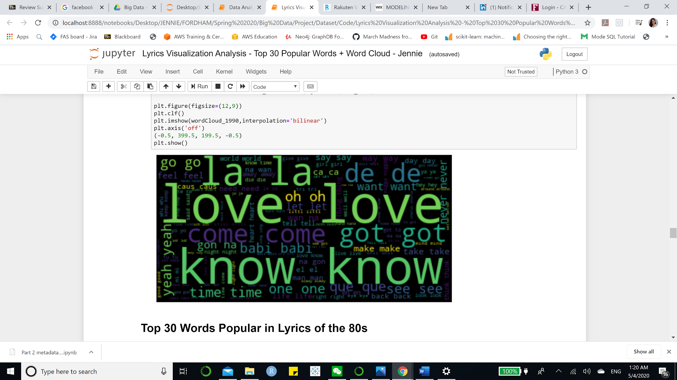
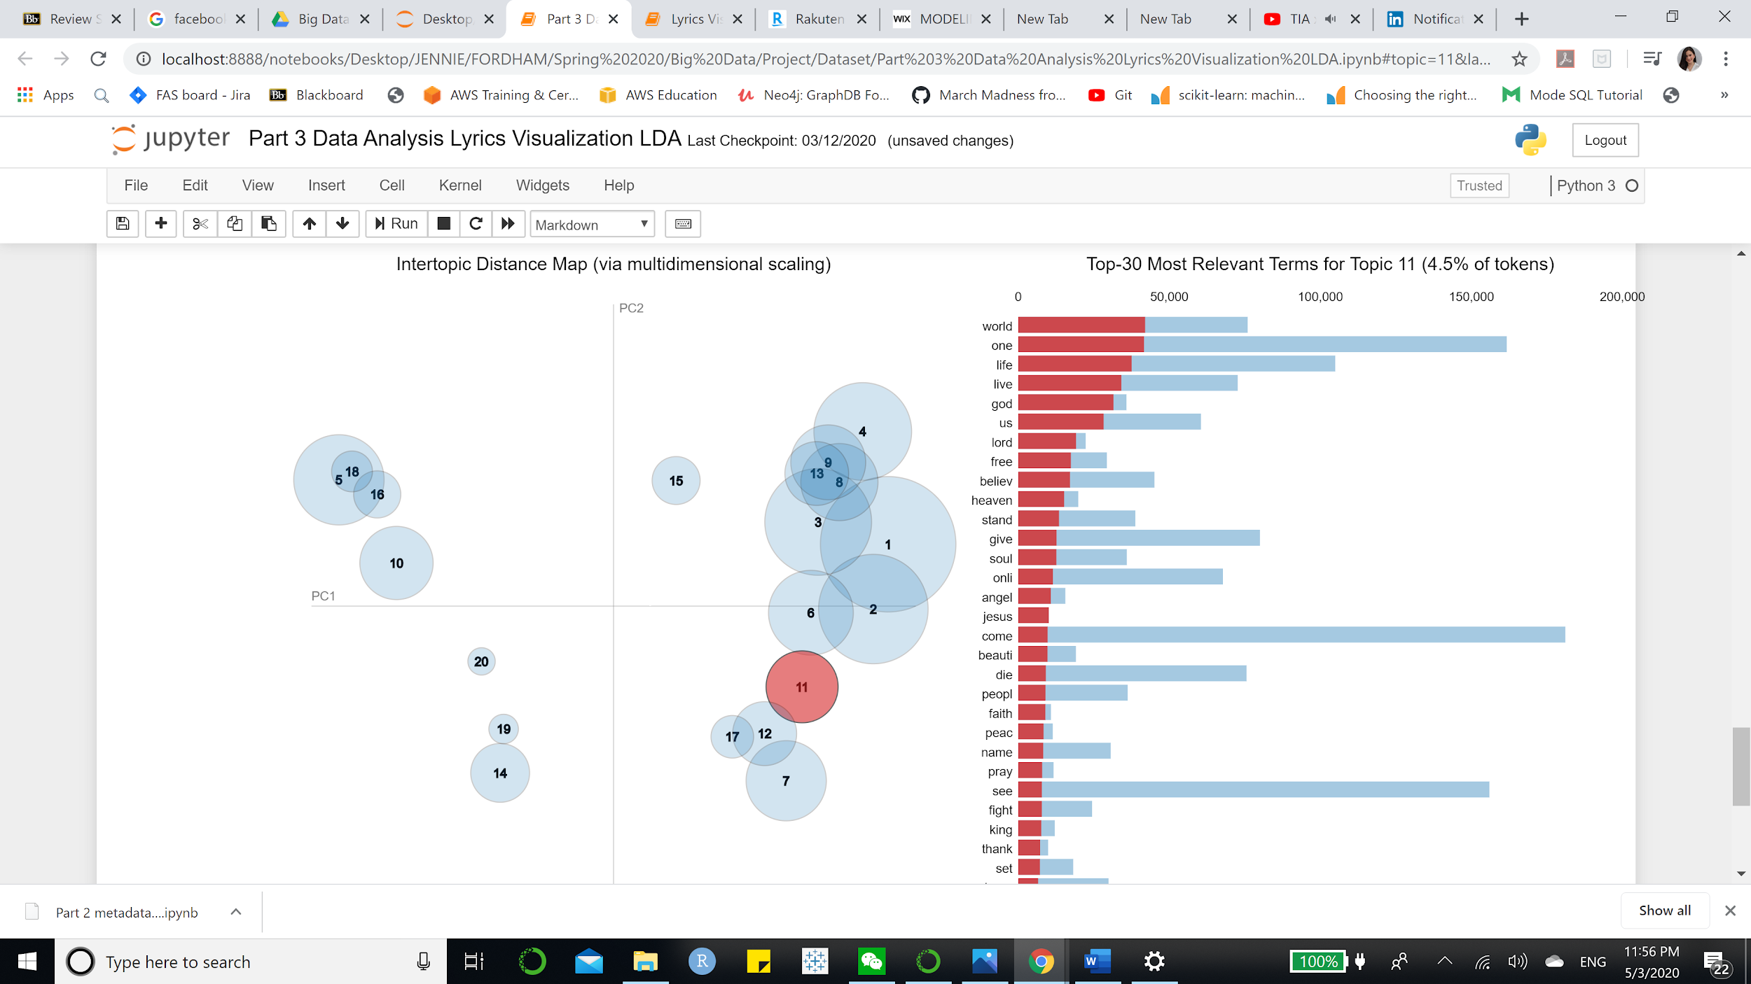
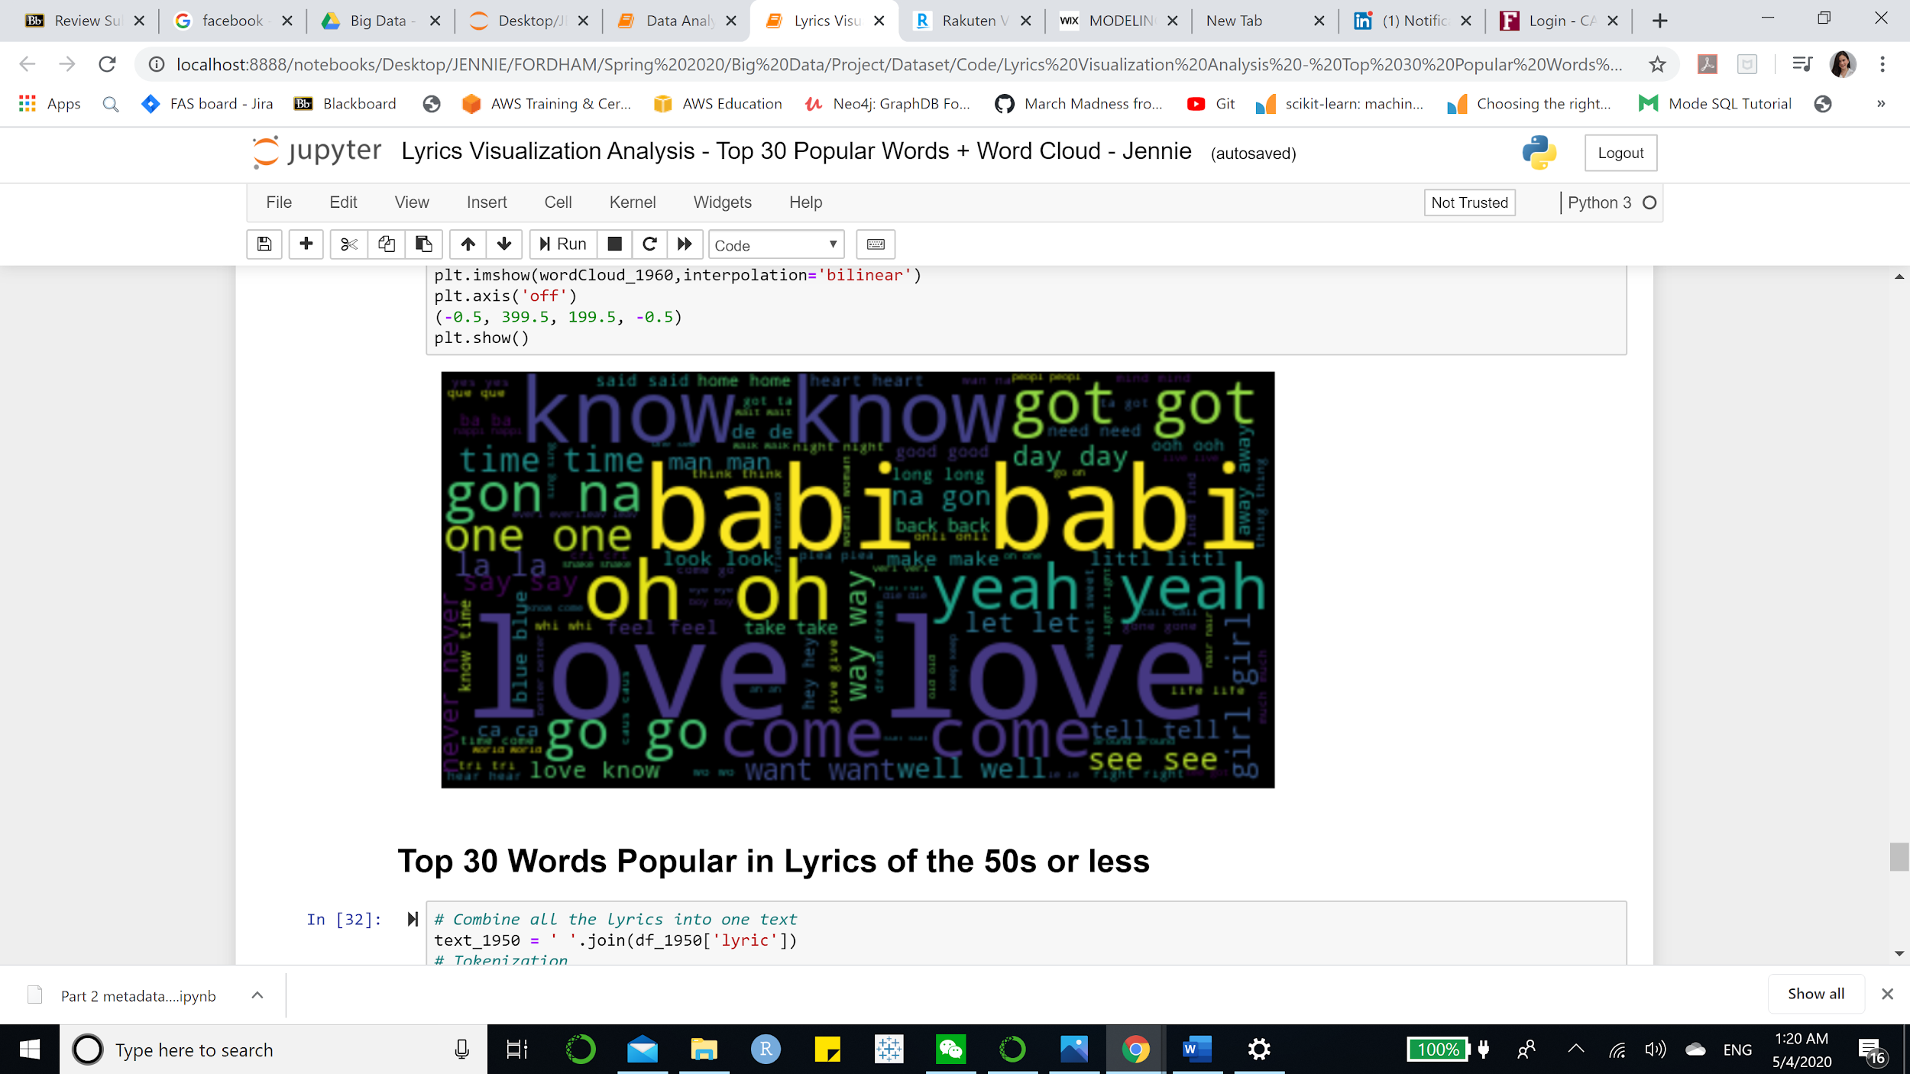
Lyrics Analysis
Topic Modeling (Cluster n=20)
Word Cloud Visualization
2000s
60s

Slide 8
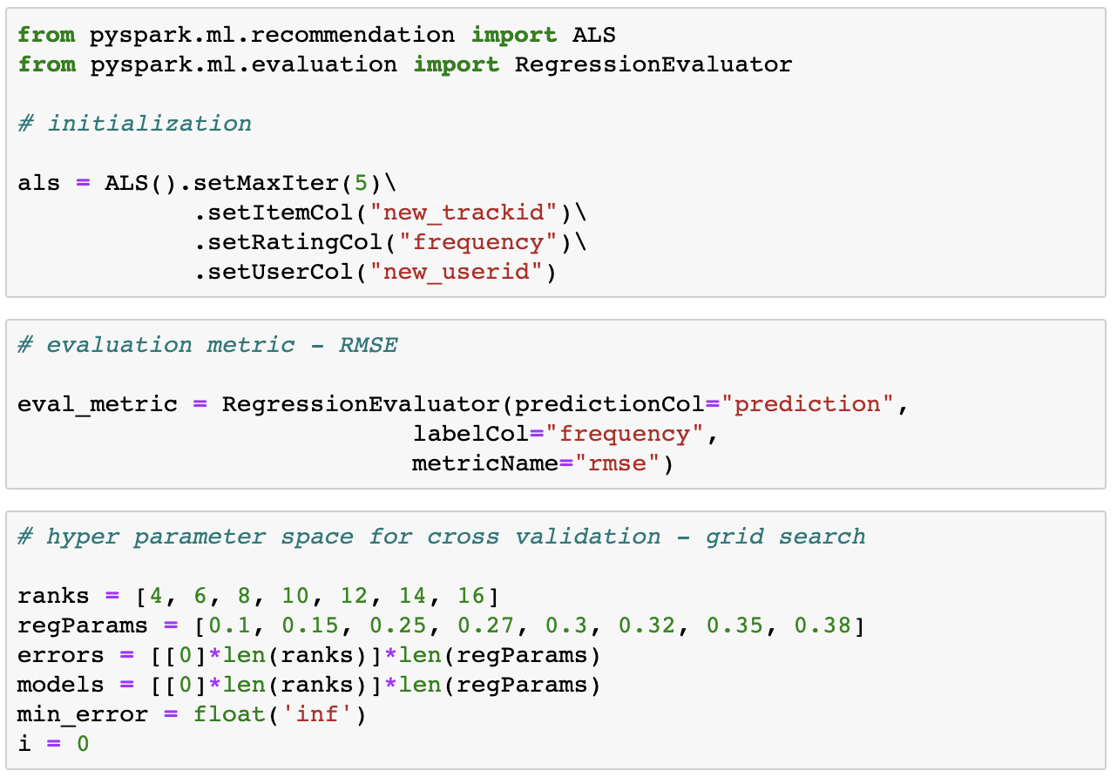
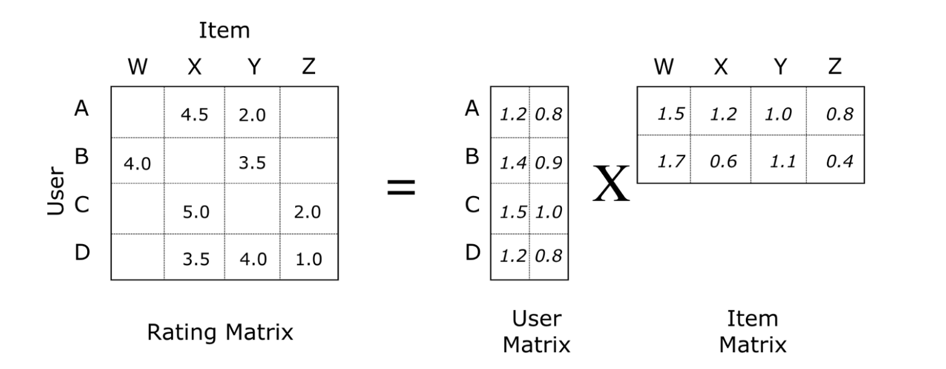
Algorithm Development | Collaborative Filtering
Popularity Based
TOP 10 frequently listened songs
ALS

Slide 9
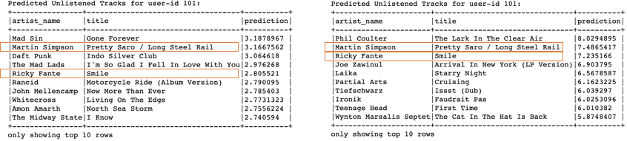
Results | ALS
Basic Recommendation
RMSE on test: 6.24
Average frequency: 3
RMSE with average frequency: 6.23
Result for user-id 101:
Recommendation for tracks listened >=2
RMSE on test: 9.21
Average frequency: 6
RMSE with average frequency: 9.23
Result for user-id 101:
Conclusion: Many songs have only been listened once. Although the second model has a higher RMSE on test, it behaves relatively better when compared to average frequency. Since those tracks are listened more, we infer those songs can better represent users’ tastes. The circled items might be of highest recommendation quality.

Slide 10
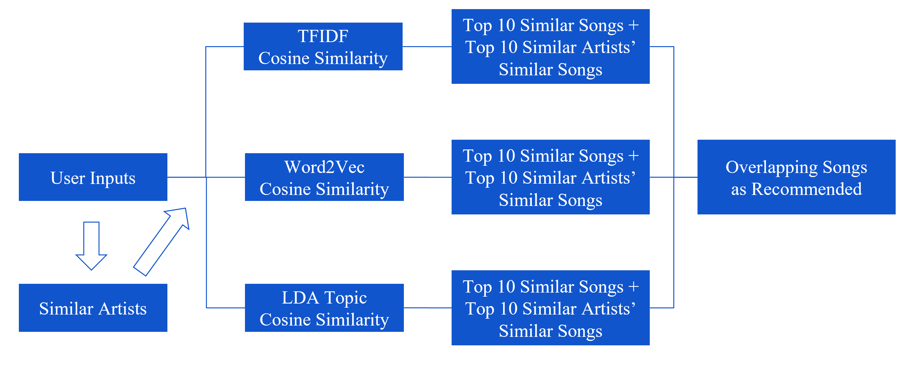
Algorithm Development | Content-Based Filtering

Slide 11
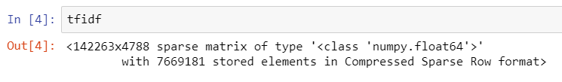
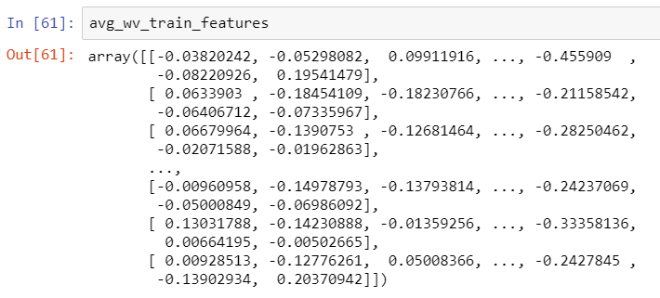
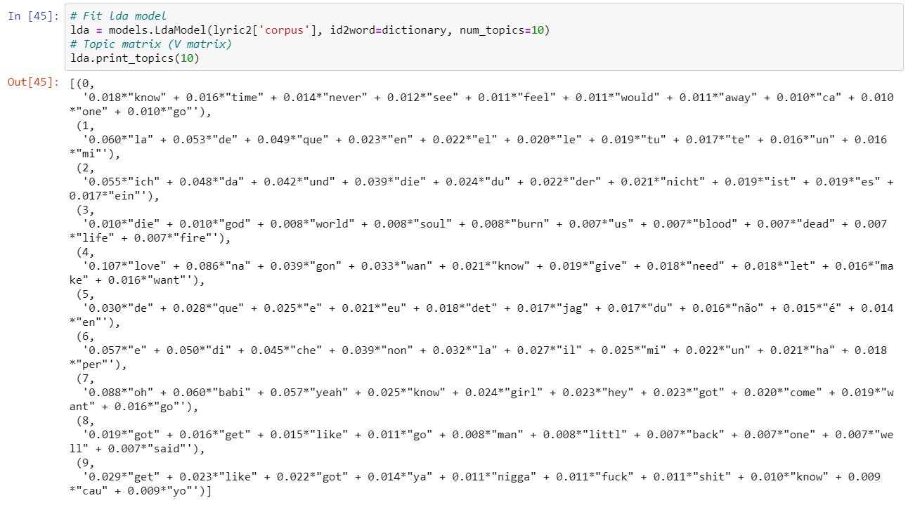
Algorithm Development | Content-Based Filtering
Features Creation
Method 1: TFIDF for Lyrics
Method 2: Word2vec for Lyrics
Method 3: LDA for Lyrics

Slide 12
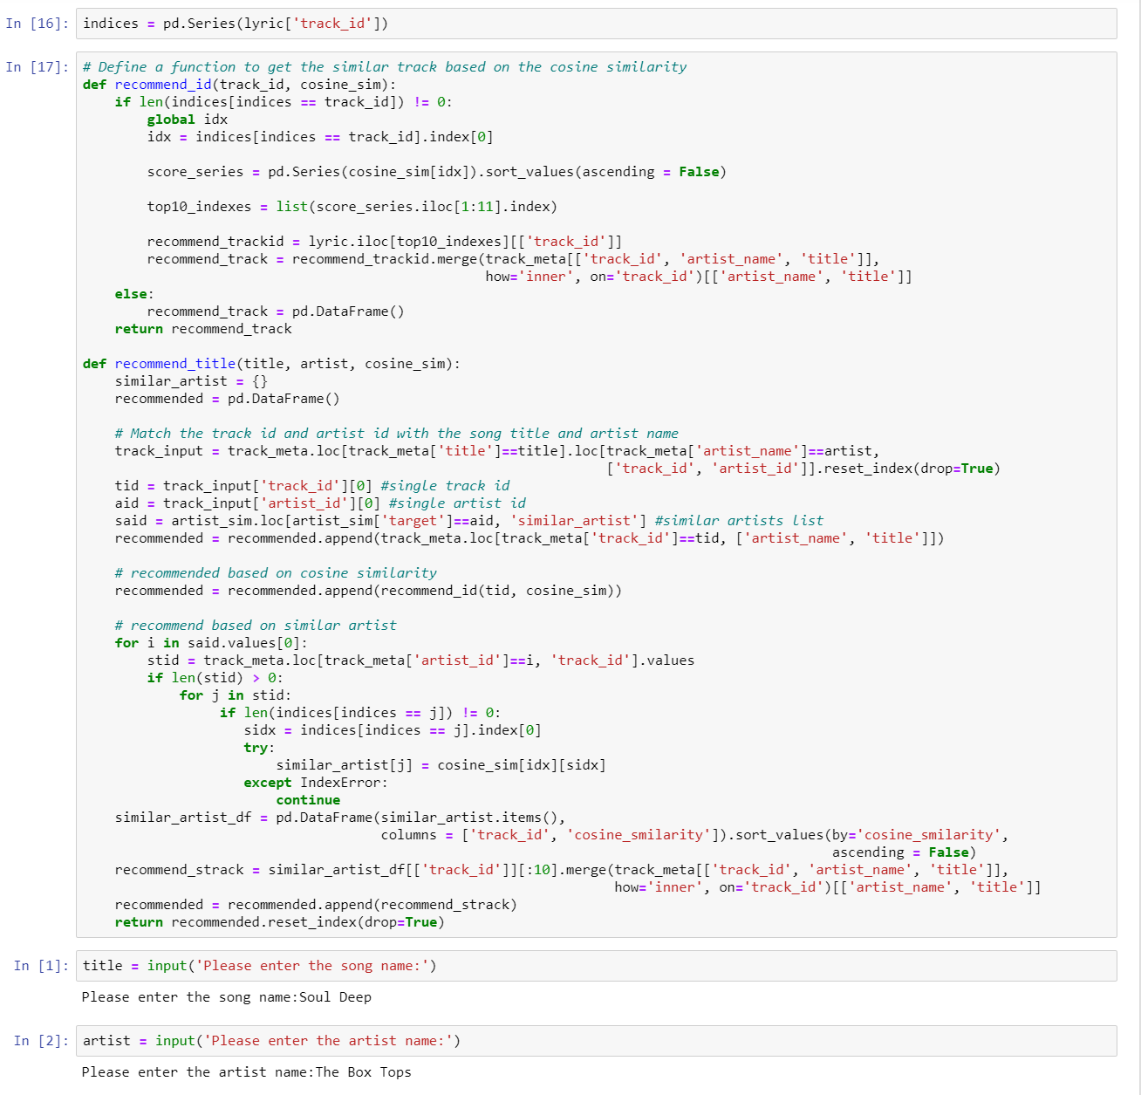
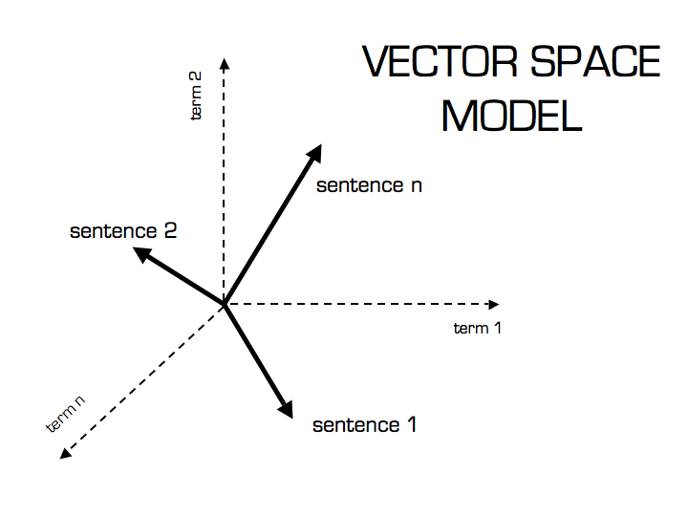
Algorithm Development | Content-Based Filtering
Cosine Similarity Calculation
System Building

Slide 13
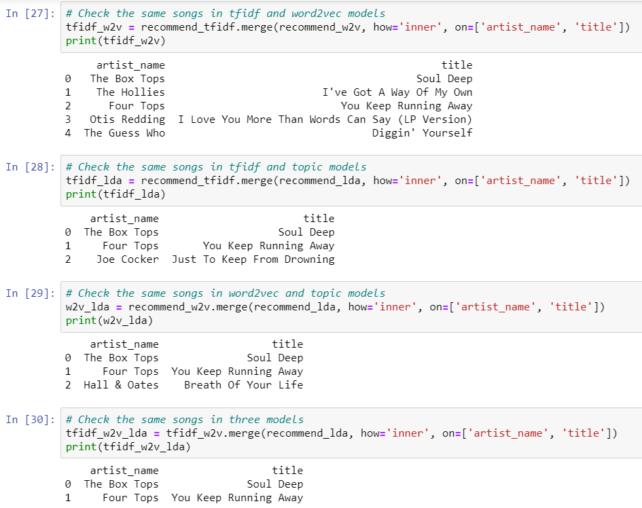
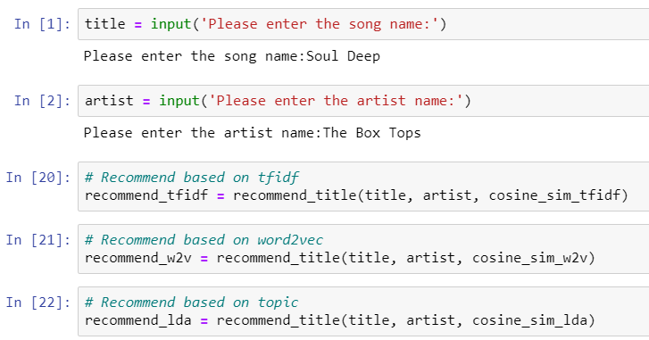
Results | Content-Based Filtering
Simulation of A New User
Recommendation

Slide 14
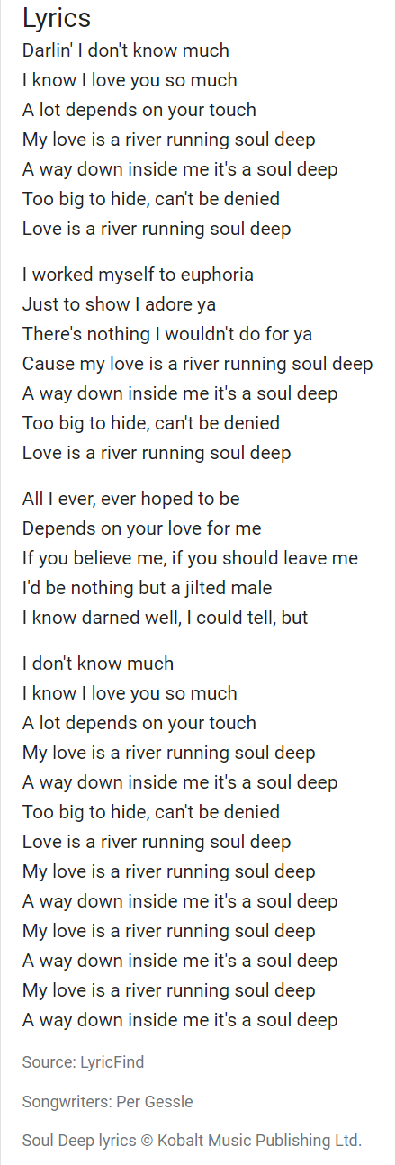
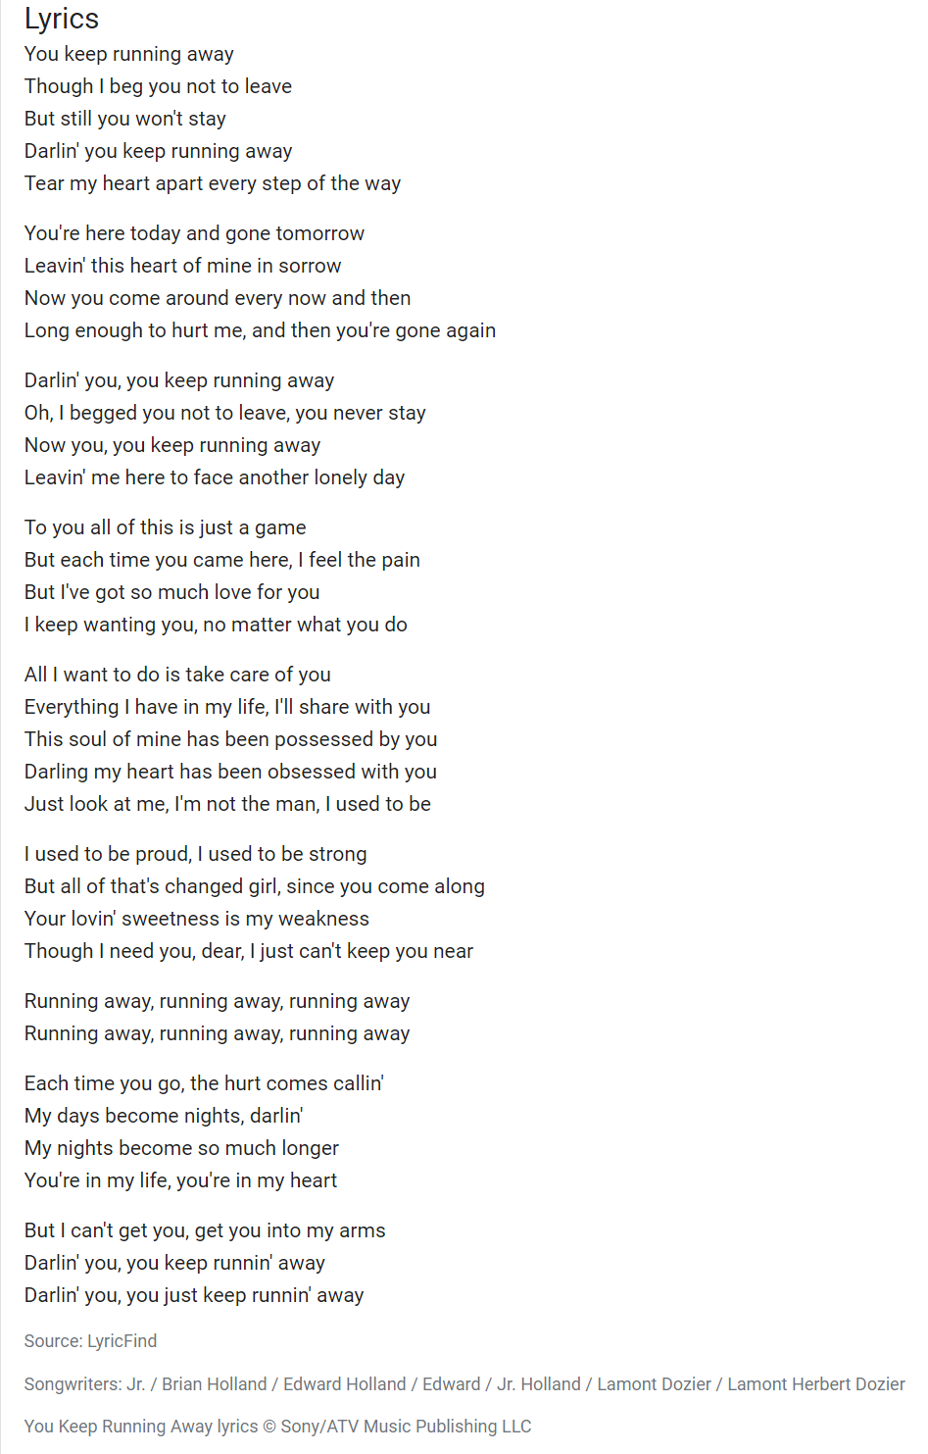
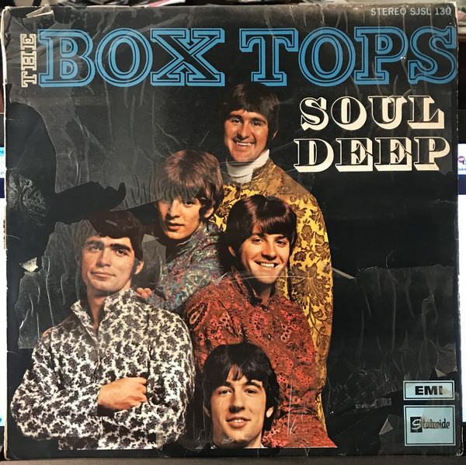
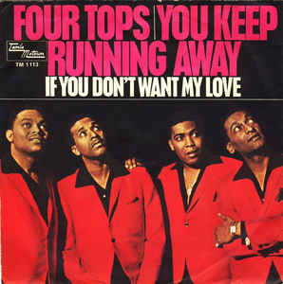
Results | Content-Based Filtering

Slide 15

Conclusions
Built a recommendation system using a dataset with 1,019,318 unique users and 384,546 unique songs.
ALS algorithm for our collaborative filtering
For old users with enough listening history to generate personalized recommendations.
Content-based recommender: combined artist similarity and lyric similarity (TF-IDF, Word2vec, and LDA modeling)
For new users with only one or a few search and listening history.
Similar songs for the current song will be recommended.
Considering that Spotify has about 2 million monthly active users, our project is close to the monthly magnitude of the industry-level.

Slide 16
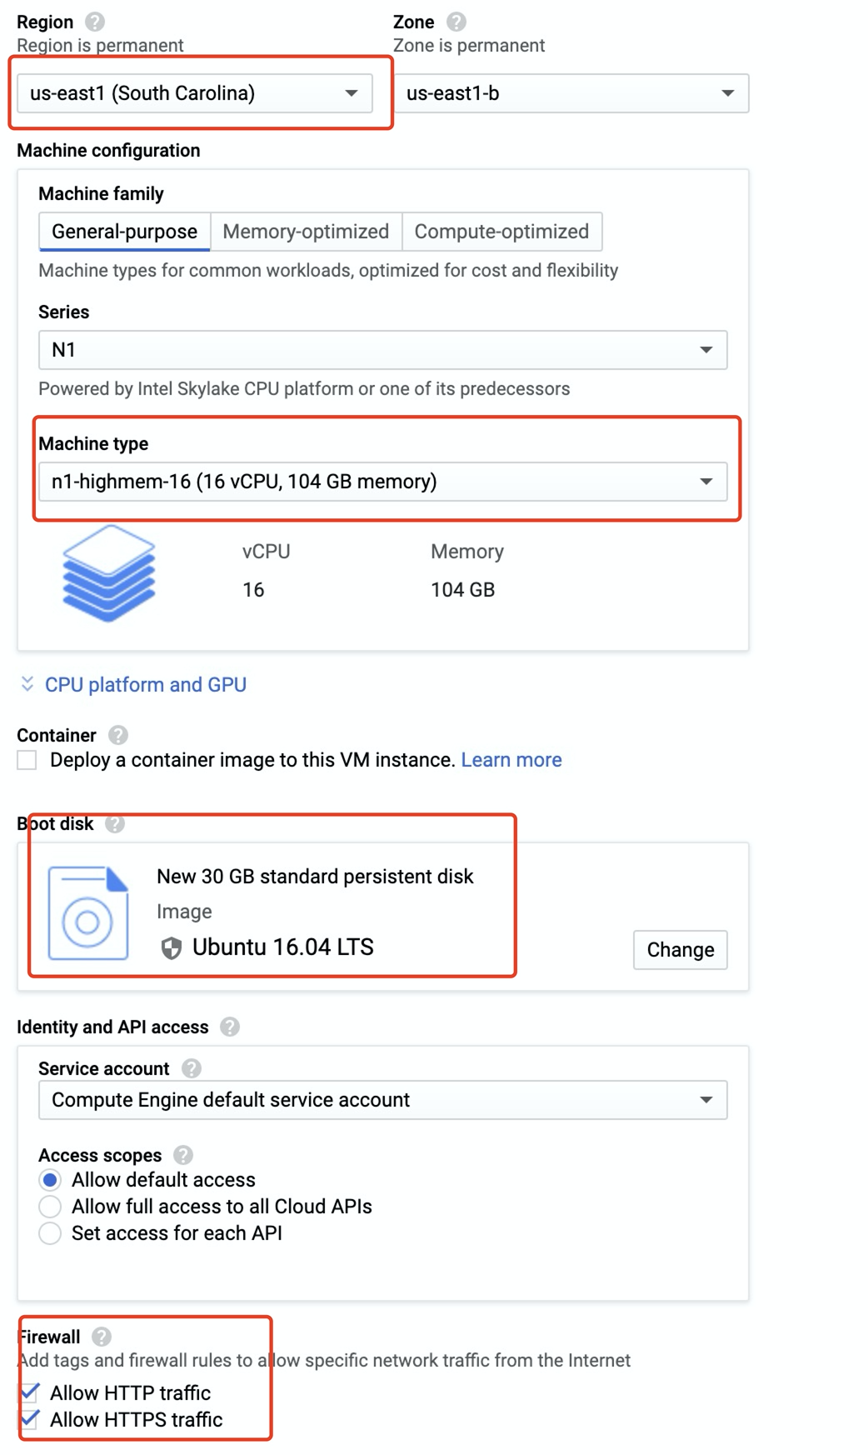
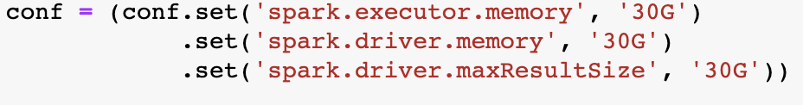
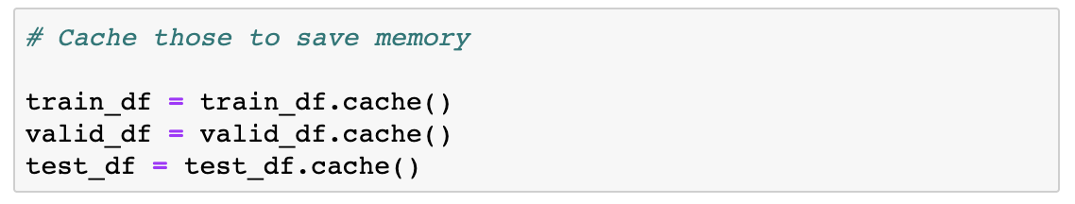
Lessons Learned
Cloud memory
Spark configuration and data types

Slide 17
Further Steps
Hybrid system
1. More dimensions of recommendation is always better
2. Google naturally combined plenty of recommendation strategies in its wide and deep recommendation system with neural networks and ensemble methods.
New Ideas
1. User2vec
2. Graph algorithms
3. Content-based filtering using music audio

Slide 18

References
A Beginner's Guide to Word2Vec and Neural Word Embeddings. (n.d.). Retrieved from https://pathmind.com/wiki/word2vec
Content-based Filtering. (2012, January 24). Retrieved from http://recommender-systems.org/content-based-filtering/
Karantyagi. (n.d.). karantyagi/Restaurant-Recommendations-with-Yelp. Retrieved from https://github.com/karantyagi/Restaurant-Recommendations-with-Yelp
Li, S. (2018, June 1). Topic Modeling and Latent Dirichlet Allocation (LDA) in Python. Retrieved from https://towardsdatascience.com/topic-modeling-and-latent-dirichlet-allocation-in-python-9bf156893c24
MODELING. (n.d.). Retrieved from https://xindizhao19931.wixsite.com/spotify2/modeling
Welcome! (n.d.). Retrieved from http://millionsongdataset.com/

Slide 19



Thank You for making us become great data scientists From Jie Lu, Li Yihao, Chaoying Bao, Tram Le

